Slide 1

CMR COLLEGE OF ENGINEERING &TECHNOLOGY
(UGC Autonomous) (NAAC Accredited with ‘A+’ Grade&NBA Accredited)
(Approved by AICTE,Permanently Affiliated to JNTU Hyderabad)
KANDLAKOYA,MEDCHAL ROAD,HYDERABAD-501401
PHASE II FINAL REVIEW
Department of Electronics and Communication Engineering
A Major Project on
Hybrid Cascade-CNN Architecture in Multi-Level Smart Parking Environments Integrating Real Time License Plate Recognition for Automated Access Control and Dynamic Spot Allocation
BATCH N0:75
TEAM DETAILS: Under the esteemed guidance of:
22H51A0432 – K. Lasya Priya Mrs. P. Annapurna Bai
22H51A0432 – J. Anulatha Assistant Professor
22H51A0426 – G. Sravya Dept.of ECE

Slide 2
Contents
Introduction
Objectives
Problem statement
Literature review
Proposed system
Methodology
Implementation
Results
Conclusion
References

Slide 3
Introduction
Rapid increase in vehicles leads to parking congestion, fuel waste, and longer searching time in urban areas.
Traditional parking systems using manual tickets or basic sensors cannot efficiently identify vehicles or manage parking spaces.
Existing solutions usually perform only vehicle detection or license plate recognition separately, lacking a complete integrated system.
This project proposes a hybrid cascade-CNN smart parking system that detects vehicles, recognizes license plates, and assigns parking spaces automatically.
The system aims to reduce parking search time, improve space utilization, and enable automated access control in multi-level parking environments.

Slide 4
Objectives of the Project
Develop an integrated system for vehicle detection, license plate recognition, and parking slot allocation
Achieve real-time performance with high accuracy using deep learning models on edge devices
Optimize parking efficiency by reducing search time and improving space utilization

Slide 5
Literature Review:
S.No | Authors & Year | Title of the Paper | Name of the Journal | Techniques / Methods Used | Major Findings (Pros & Cons)
1 | Rahman & Ahmed (2023) | IoT-enabled wireless sensor networks for parking occupancy monitoring | IEEE Sensors Journal | IoT sensors, LoRaWAN, distributed occupancy monitoring | Pro: Energy-efficient large-scale monitoring with stable accuracy (~94.7%). Con: Only detects presence; cannot identify vehicles or support intelligent decisions.
2 | Fernandez et al. (2024) | Edge-deployable parking occupancy monitoring using lightweight neural networks | IEEE Internet of Things Journal | MobileNetV3, edge computing, vision-based detection | Pro: Low-latency (~34ms) and robust under varying lighting conditions. Con: Performance depends on camera placement; limited semantic understanding.
3 | Nguyen & Tran (2024) | YOLOv8 optimization for parking-specific vehicle detection | Neurocomputing | YOLOv8, multi-scale feature fusion | Pro: High detection accuracy (~97.9%) with strong occlusion handling. Con: Performance degrades under extreme real-world conditions like weather/lighting.
4 | Silva & Costa (2024) | Spatial transformer networks for license plate recognition | Neural Networks | Spatial Transformer Networks, attention-based OCR | Pro: Corrects geometric distortions and improves recognition reliability. Con: Adds computational overhead and struggles with severe occlusion.

Slide 6
S.No | Authors & Year | Title of the Paper | Name of the Journal | Techniques / Methods Used | Major Findings (Pros & Cons)
5 | Zhou & Wang (2024) | Transformer-based sequence modeling for license plate recognition | Computer Vision and Image Understanding | Transformer-based OCR, sequence modeling | Pro: Captures long-range dependencies, improving recognition accuracy (~96.8%). Con: High computational complexity, limiting real-time edge deployment.
6 | Chen & Zhang (2024) | Deep reinforcement learning for dynamic parking allocation | Transportation Research Part C | Deep Q-learning, reinforcement learning | Pro: Learns adaptive allocation strategies, improving space utilization (~91%). Con: High training and inference cost; not suitable for real-time peak scenarios.
7 | Krishnan & Gupta (2023) | Graph-based optimization for multi-level parking management | Computers & Operations Research | Graph optimization, minimum-cost flow | Pro: Provides optimal and scalable allocation with fast computation. Con: Assumes static inputs; lacks real-time adaptability to changing occupancy.
8 | Sailaja et al. (2024) | CNN with YOLOv4 for real-time object detection | Springer Conference | CNN + YOLOv4 | Pro: Enables real-time detection with single-stage processing. Con: Lower accuracy and efficiency compared to advanced models like YOLOv8.

Slide 7
Proposed System
The proposed system is a hybrid cascade CNN-based smart parking system. It integrates vehicle detection, license plate recognition, and parking slot allocation into a unified pipeline.
The system uses YOLOv8 for real-time vehicle detection. It applies MobileNet, CNN, and BiLSTM models for accurate license plate recognition.
The recognized plate is matched with a central database for vehicle identification. A dynamic parking allocation algorithm is used to assign the best parking slot.
The allocation considers factors such as availability, distance, and vehicle size. The entire system runs on an edge device, achieving low latency of 127 ms.

Slide 8
Comparision Table
Reference | Methodology | Detection Accuracy | Recognition Accuracy | Processing Time | Allocation | Limitation
Rahman & Ahmed (2023) | IoT sensor network | 94.7% | N/A | 180 ms | Static | No identification
Fernandez et al. (2024) | MobileNetV3 vision | 96.3% | N/A | 34 ms | None | Detection only
Nguyen & Tran (2024) | YOLOv8 detection | 97.9% | N/A | 28 ms | None | No recognition
Silva & Costa (2024) | STN + attention | N/A | 95.4% | 156 ms | None | Recognition only
Zhou & Wang (2024) | Transformer OCR | N/A | 96.8% | 89 ms | None | No detection
Chen & Zhang (2024) | RL allocation | N/A | N/A | N/A | Dynamic | No vision
Krishnan & Gupta (2023) | Graph optimization | N/A | N/A | N/A | Dynamic | Assumes known vehicles
Proposed | Cascade CNN | 98.2% | 94.8% | 127 ms | Dynamic | Integrated

Slide 9
Block Diagram
CNN
(character recognization by OCR)
YOLOV8
(vehicle detection)
Localization
(MobileNETv3-FPN)
IMAGE CAPTURING
Dynamic spot allocation
Display

Slide 10
Methodology / System Design
System Overview The system uses 3 stages — detect vehicle, find number plate, read plate characters — and automatically assigns a parking spot. Everything runs on a small edge computer at the entry gate in just 127ms.
1. Vehicle Detection (Stage 1) YOLOv8-nano model detects the vehicle from camera feed in 23ms. It was trained on 15,000 parking images covering day, night, and different angles. Achieves 98.2% accuracy.
2. Plate Reading (Stage 2 & 3) MobileNetV3 crops and straightens the plate. Then a 6-layer CNN + BiLSTM reads the characters and converts them to plate text. Achieves 94.8% character recognition accuracy.
3. Spot Allocation Matched plate is checked in a database. Best parking spot is assigned based on available space, distance, and vehicle size. Reduces parking search time by 43.6%. Total processing = 127ms.

Slide 11
Hardware & Software Requirements
Software Require
Python Programming Language – Used to develop the system pipeline.
YOLOv8 Model – Vehicle detection module.
CNN-based OCR Model – License plate character recognition.
PostgreSQL Database – Stores vehicle records and parking information.
Computer Vision Libraries (OpenCV, Deep Learning Frameworks) – Image processing and model execution.
Hardware Require
High-resolution Cameras – Capture vehicle images at entry, exit, and parking levels.

Slide 12
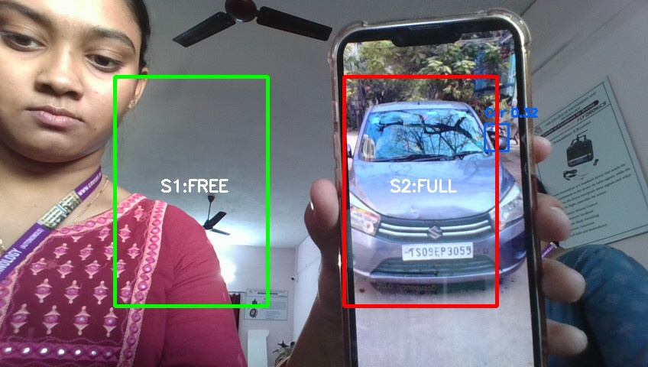
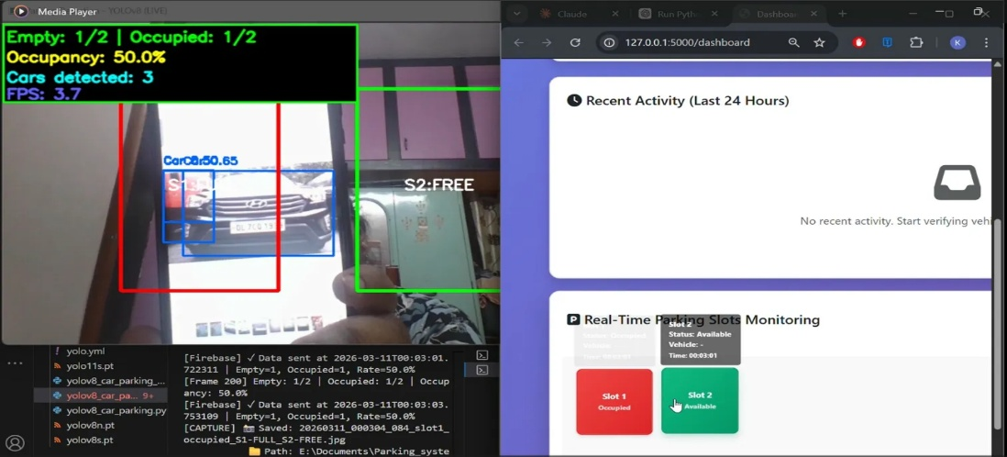
Implementation
Fig: Detected vehicle in the slot
Fig : Real-time YOLOv8 vehicle detection output showing slot occupancy status

Slide 13
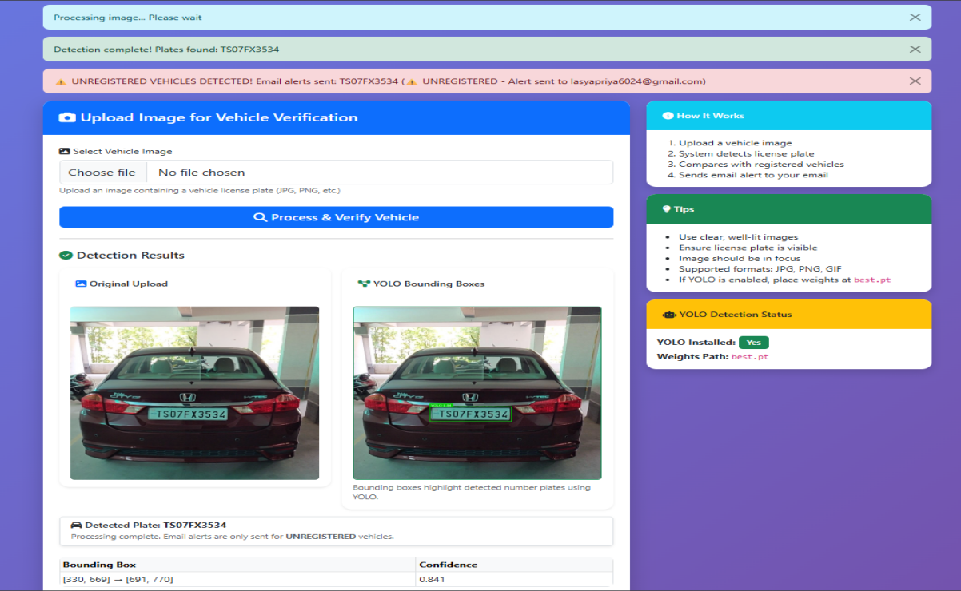
Implementation:
Fig: License plate localization and character recognition output showing detected plate

Slide 14
Calculation:
Stage – 1: Vehicle detection accuracy
Detection Accuracy (%) = (Number of Correct Detections / Total Vehicle Events) × 100
Total vehicles = 25,847
Out of these correctly detected 25,381 vehicles
Missed (not detected) = 25,847 − 25,381 = 466 vehicles
Accuracy = (25,381 ÷ 25,847) × 100 = 98.2%
Stage 2 — Plate Localization
From 24,465 detected vehicles
806 localization failures
Success = 24,465 − 806 = 23,659
23,659 ÷ 24,465 × 100 = 96.7%

Slide 15
Stage 3 : Recognition accuracy
Vehicles detected in previous stage = 25,381
Plates successfully found = 24,543 (that is 96.7% of 25,381)
Out of those, characters correctly read = 23,267 plates
Errors = 24,543 − 23,267 = 1,247 errors
Accuracy = (23,267 ÷ 24,543) × 100 = 94.8%
End-to-End accuracy
All 3 stages must succeed together: 98.2% × 96.7% × 94.8% = 90.3%
25,847 × 0.903 = 23,342 fully successful entries
3 Stage wise latency
Stage-1 Detection = 23 ms
Stage-2 Localization = 31 ms
Stage-3 Recognition = 58 ms
Database + Allocation = 15 ms
Total Latency = 23 + 31 + 58 + 15 = 127 ms

Slide 16
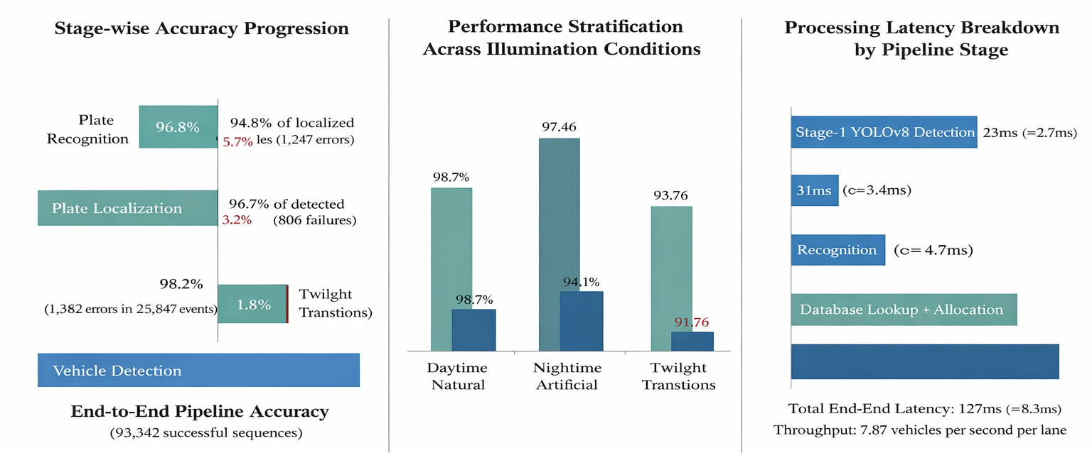
Results & Graphs:
Figure : Component-wise accuracy analysis across processing stages and environmental conditions.

Slide 17
Conclusion
A smart parking solution based on a hybrid cascade-CNN architecture is developed to integrate real-time vehicle detection, license plate recognition, and dynamic slot allocation for multi-level parking environments. The proposed three-stage processing pipeline delivers high accuracy with a fast 127 ms execution time, enabling support for up to 28 vehicles per minute. By applying an intelligent dynamic allocation strategy, the system minimizes parking search time and improves overall space utilization, while its edge-based implementation ensures stable and reliable performance during continuous real-world operation.

Slide 18
References
Rahman and S. Ahmed, “IoT-enabled wireless sensor networks for distributed parking occupancy monitoring,” IEEE Sensors Journal, vol. 23, no. 12, pp. 13456–13468, 2023.
M. Fernandez, A. Garcia, and P. Rodriguez, “Edge-deployable parking occupancy monitoring using lightweight neural networks,” IEEE Internet of Things Journal, vol. 11, no. 4, pp. 5623–5637, 2024.
T. Nguyen and H. Tran, “YOLOv8 optimization for parking-specific vehicle detection with multi-scale feature fusion,” Neurocomputing, vol. 572, p. 127189, 2024.
P. Silva and M. Costa, “Spatial transformer networks for geometric normalization in license plate recognition,” Neural Networks, vol. 172, p. 106089, 2024.
Y. Zhou and M. Wang, “Transformer-based sequence modeling for license plate character recognition,” Computer Vision and Image Understanding, vol. 241, p. 103945, 2024.
L. Chen and W. Zhang, “Deep reinforcement learning for dynamic parking space allocation in smart cities,” Transportation Research Part C: Emerging Technologies, vol. 159, p. 104478, 2024.
J. Anderson and K. Brown, “Attention-enhanced YOLO architectures for vehicle detection in congested parking environments,” IEEE Transactions on Intelligent Transportation Systems, vol. 24, no. 7, pp. 7234–7248, 2023.

Slide 19
THANK YOU

